Slide 1
Main Updates
Happy New Year!
Reorganizing my analysis pipeline to smooth data first, then calculate Cp
Manuscript plans

Slide 2
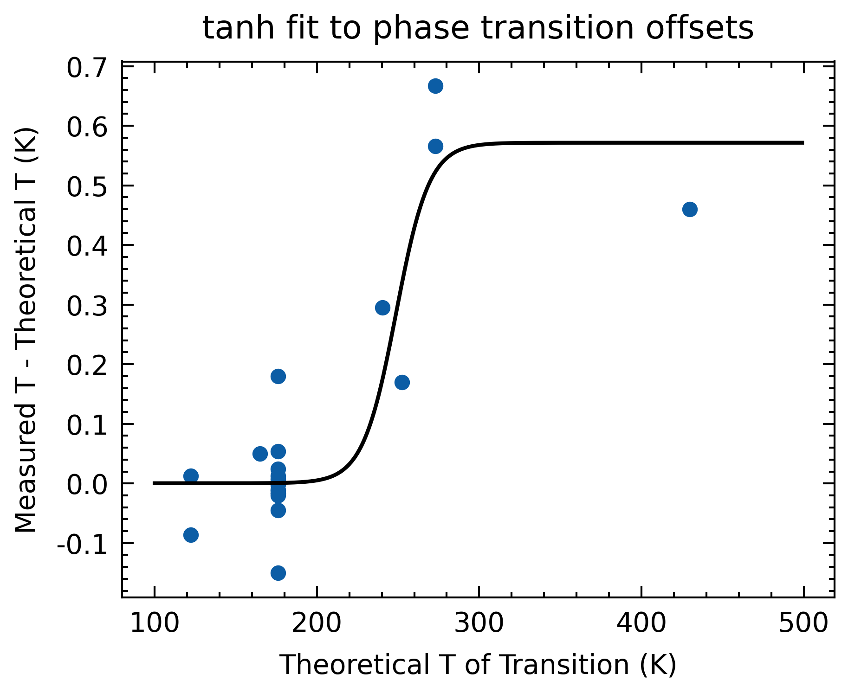
Hyperbolic tangent fit
With Temperature Offset (tanh)
T_offset from tanh (K) | Adjusted T (K) | adjusted wt% | absolute error | relative error (%)
0.5 | 267.2 | 5.2 | 0.5 | 9.6
0.5 | 262.3 | 8.2 | 0.3 | 3.7
0.5 | 262.0 | 8.4 | 0.3 | 3.6
0.4 | 259.2 | 10.0 | 0.2 | 2.0
0.3 | 250.4 | 14.3 | 0.1 | 0.7
0.1 | 235.1 | 20.07 | 0.03 | 0.1
0.01 | 207.4 | 26.912 | 0.002 | 0.007

Slide 3
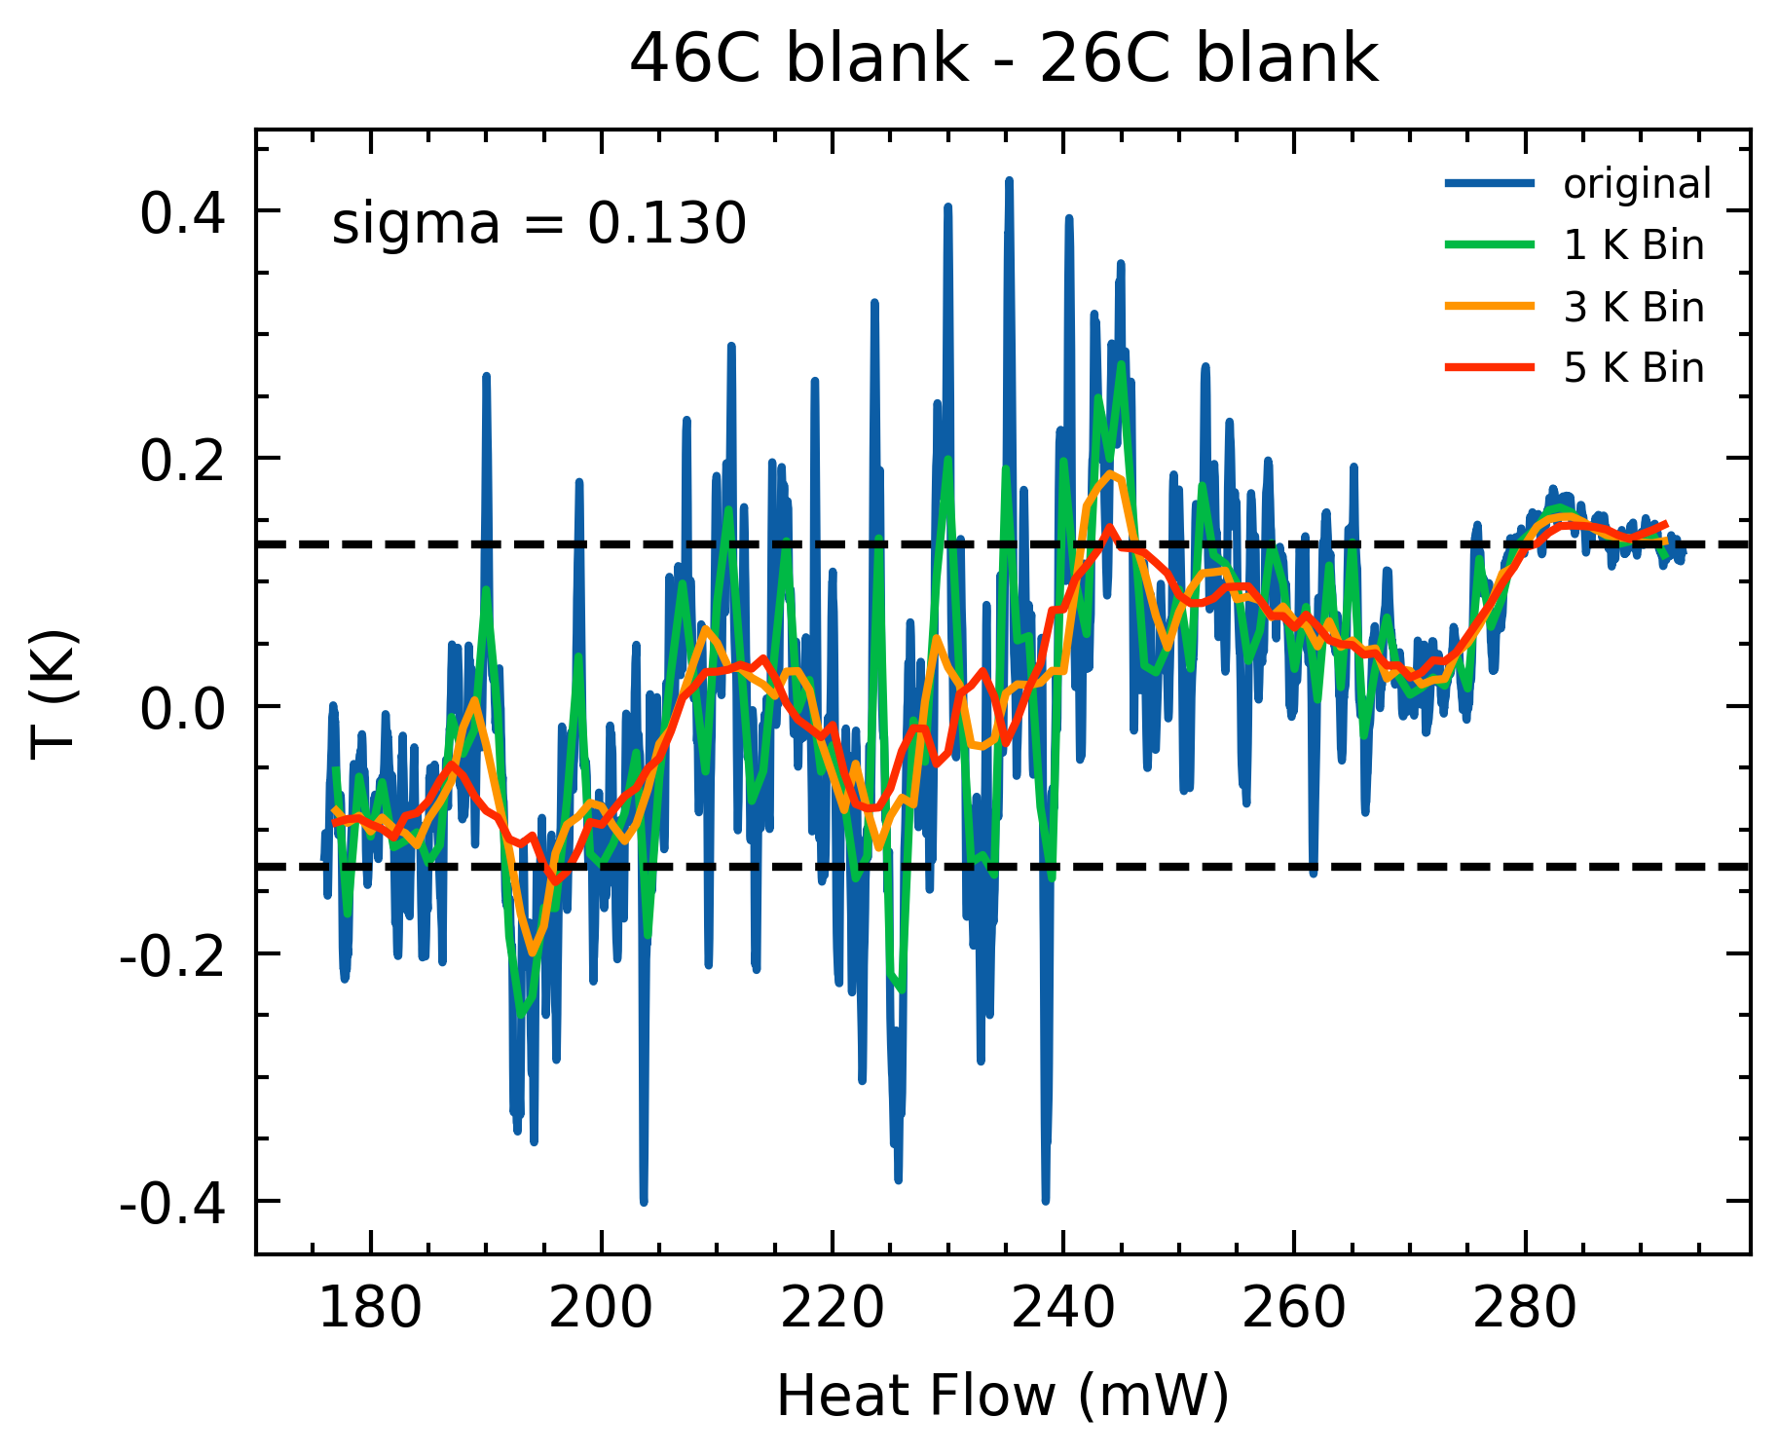
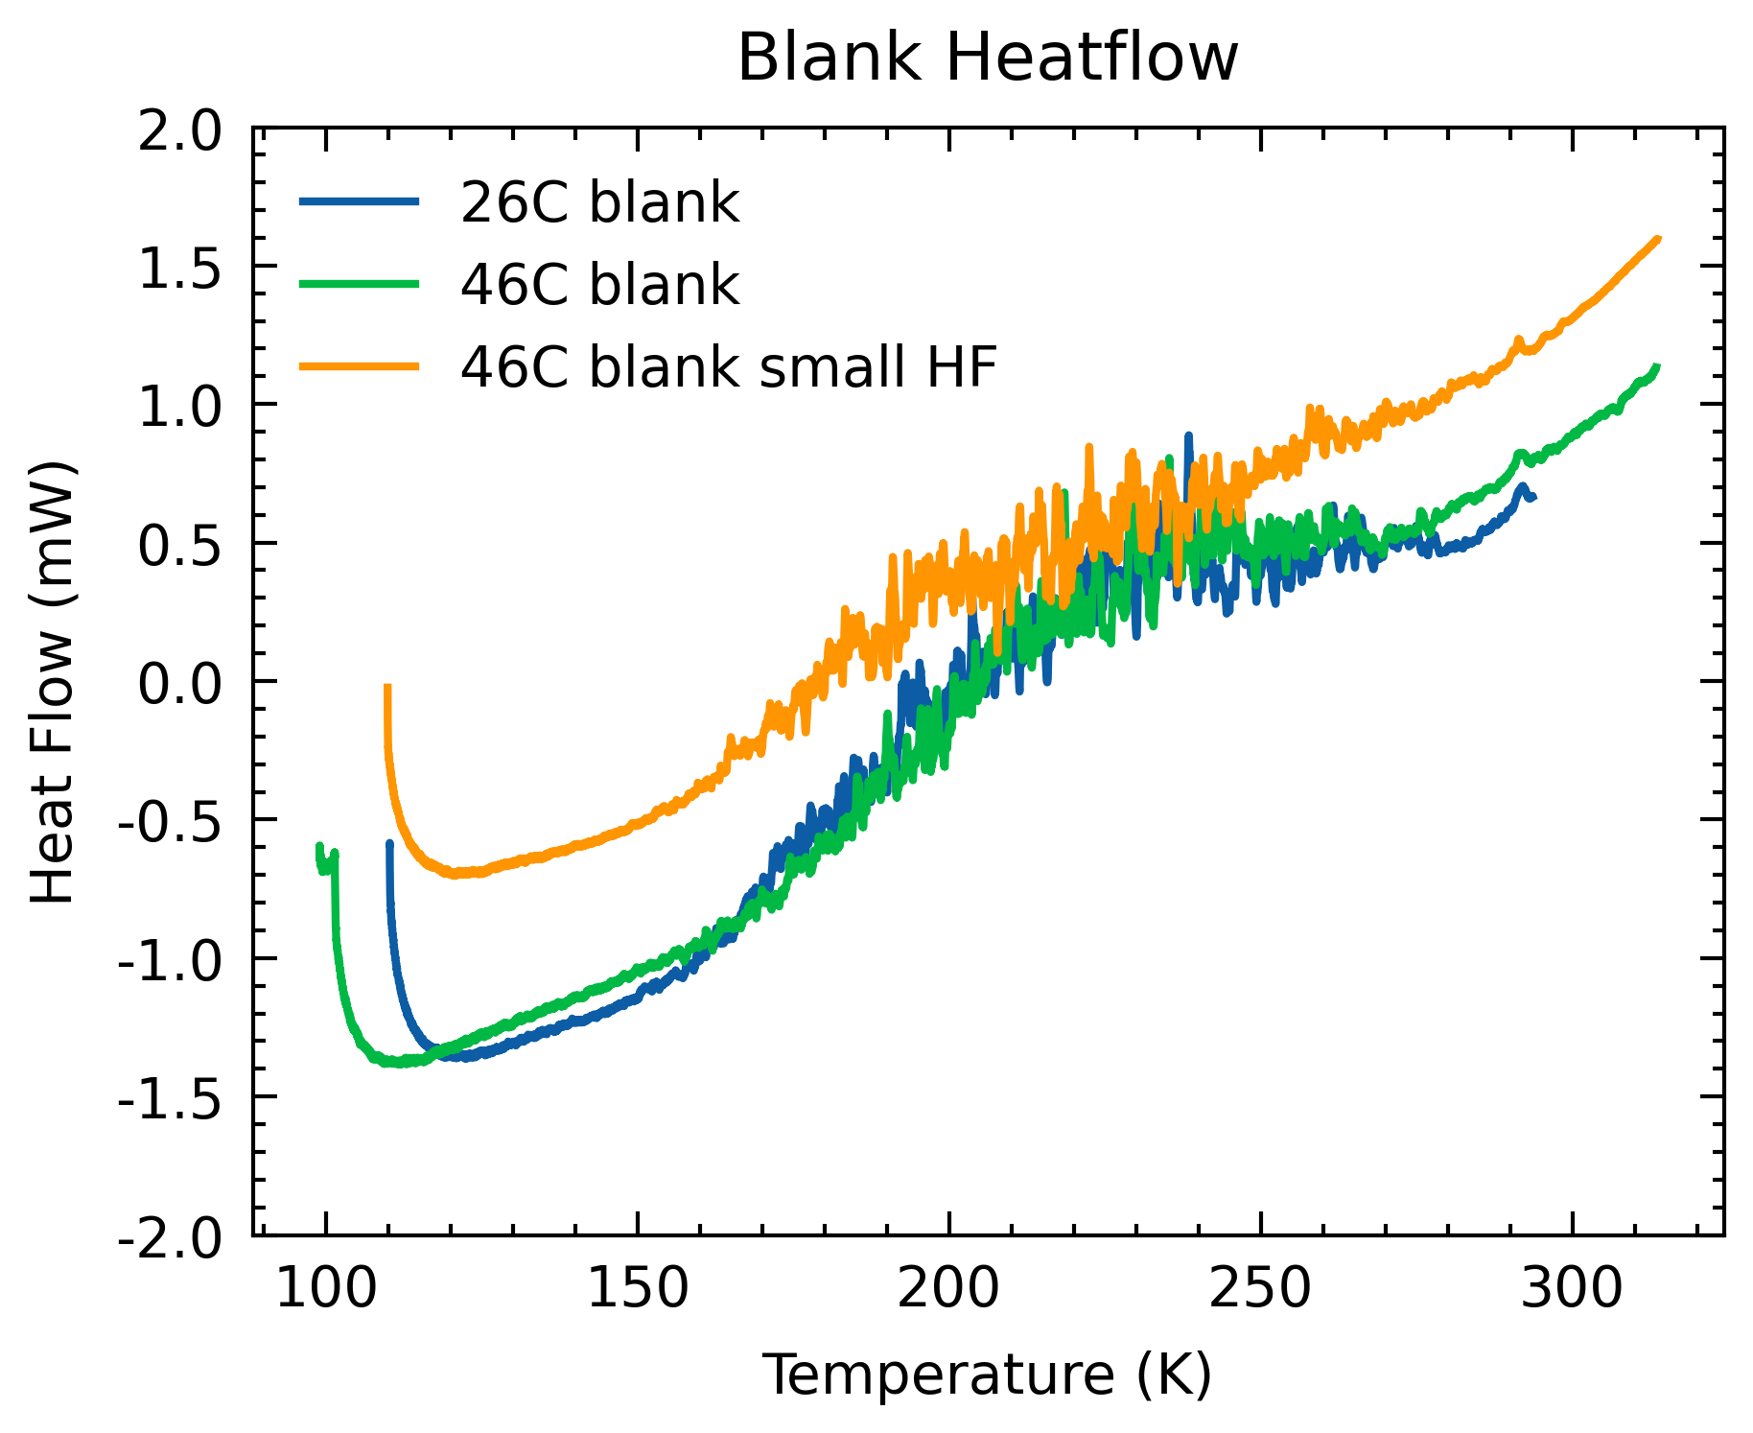
Smoothing before Calculations
Chose 3K bins
Took 1-sigma of the difference between the 2 blanks.

Slide 4
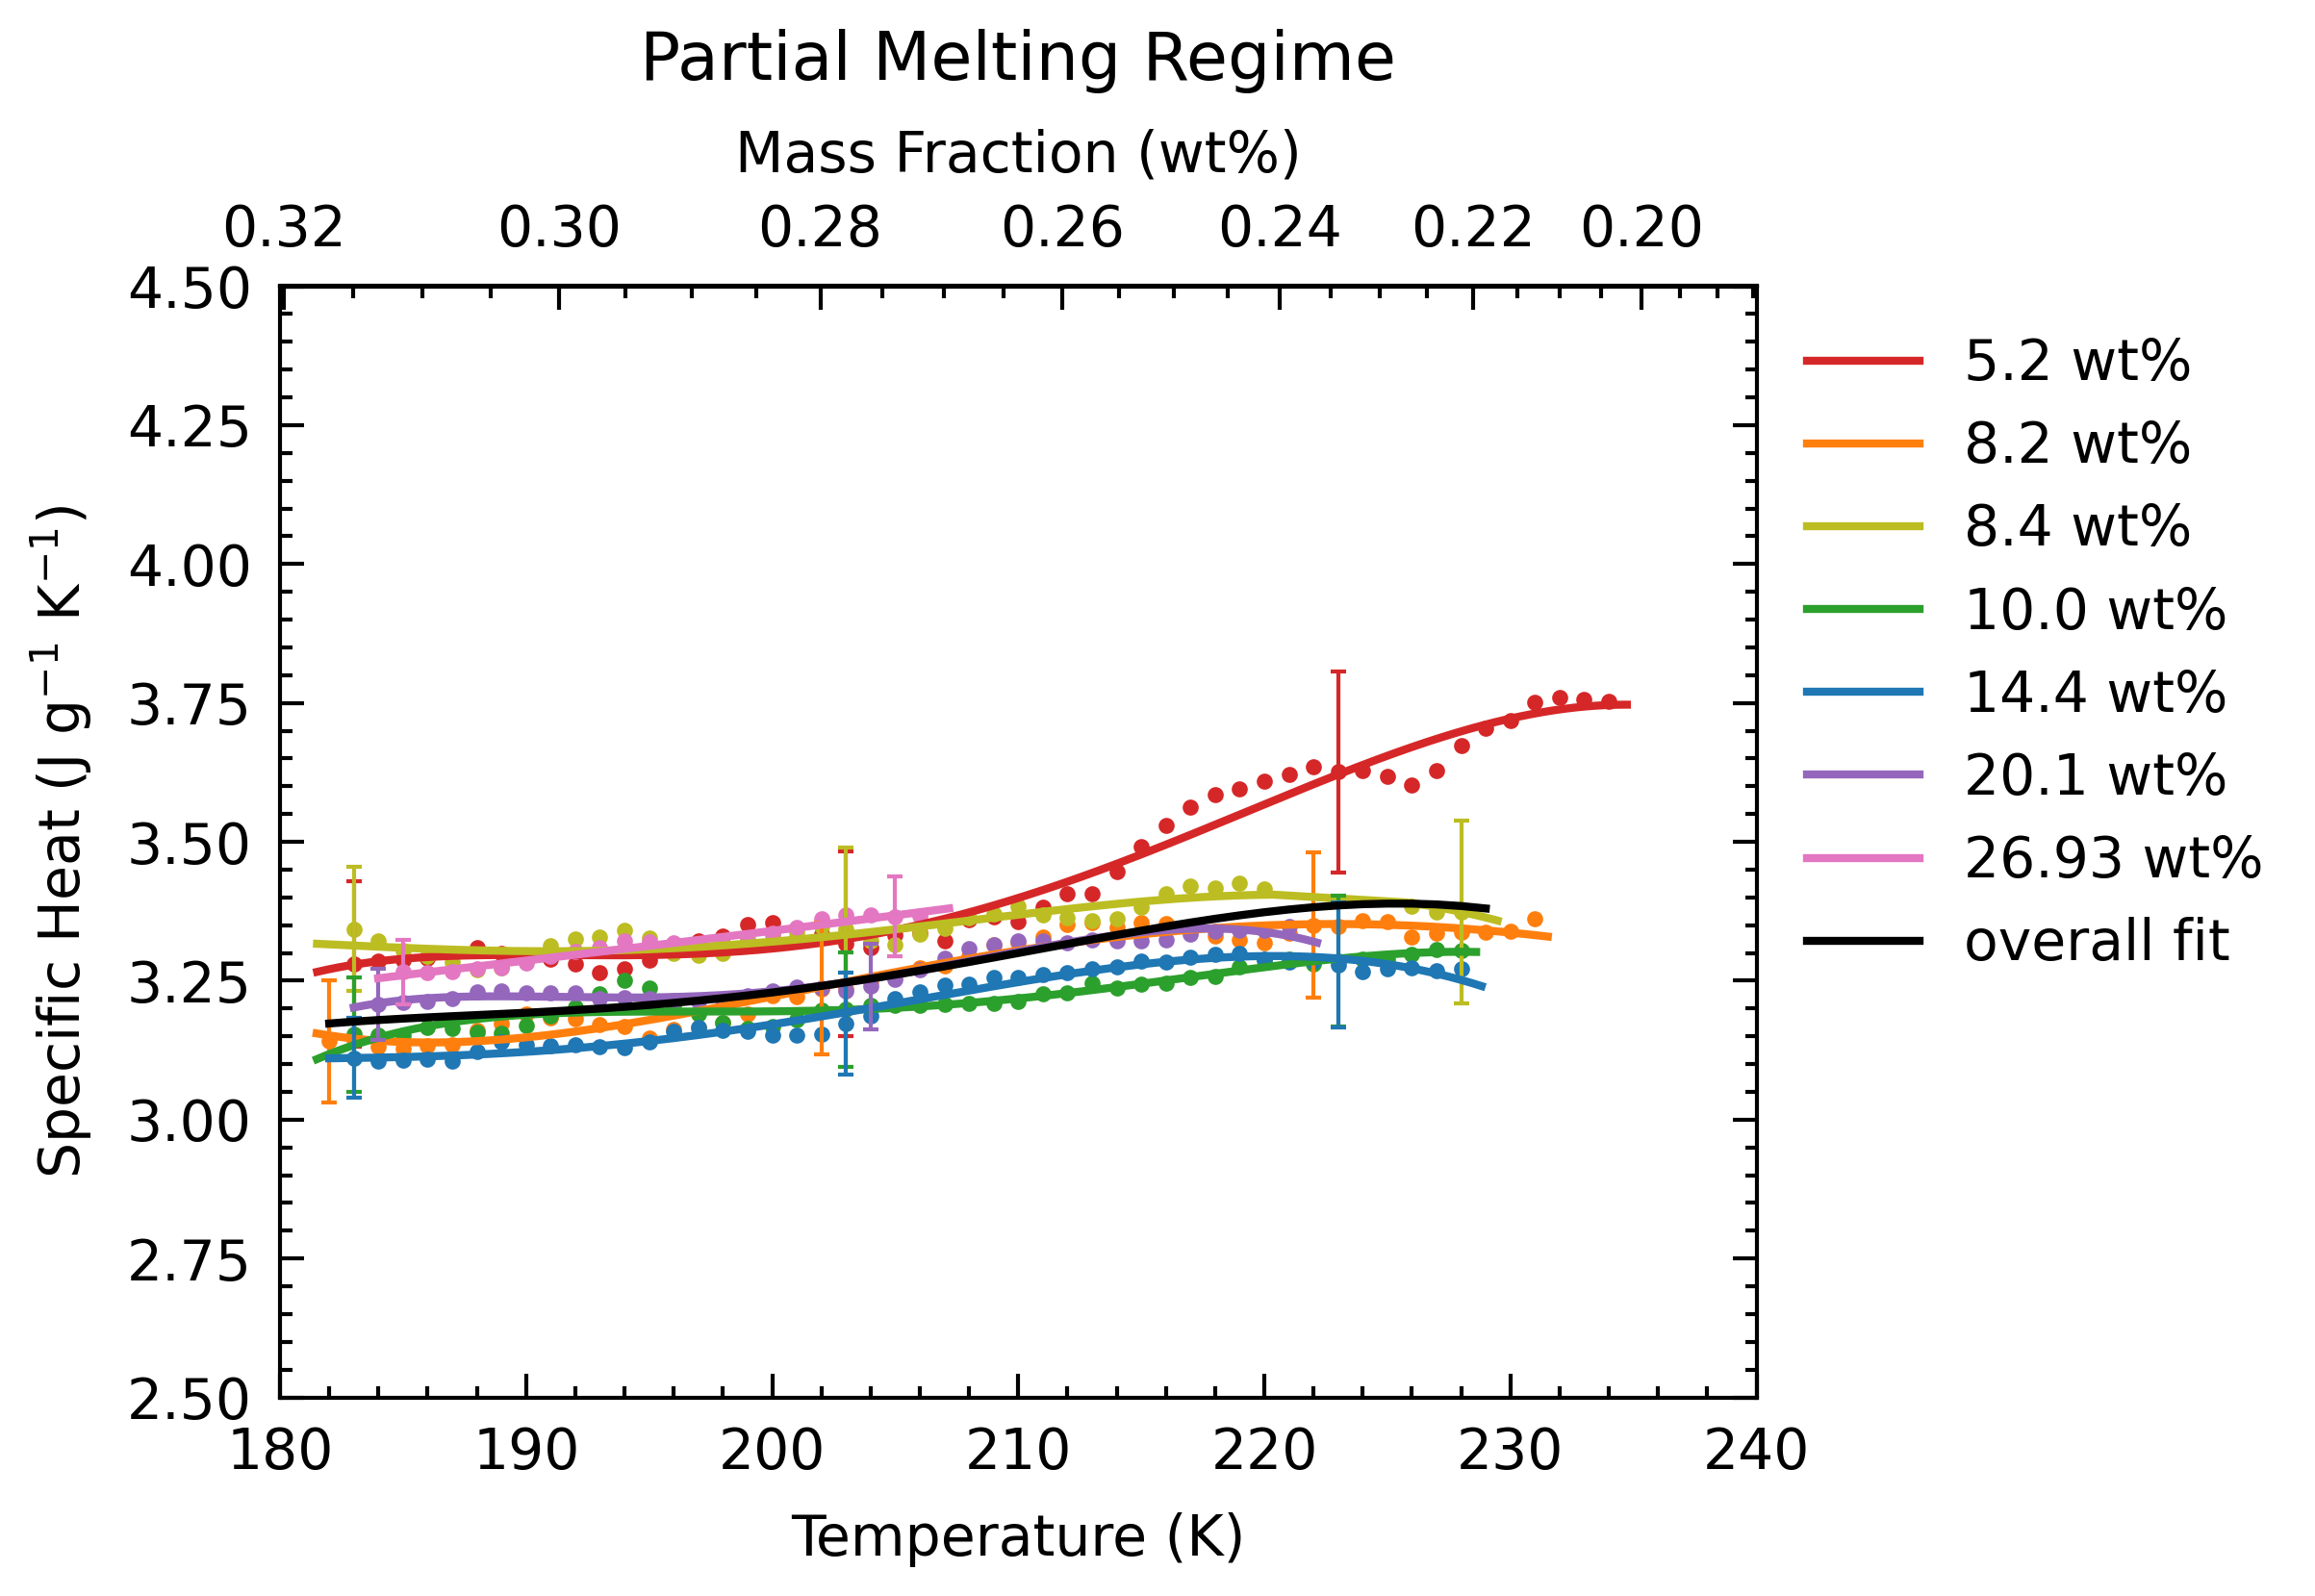
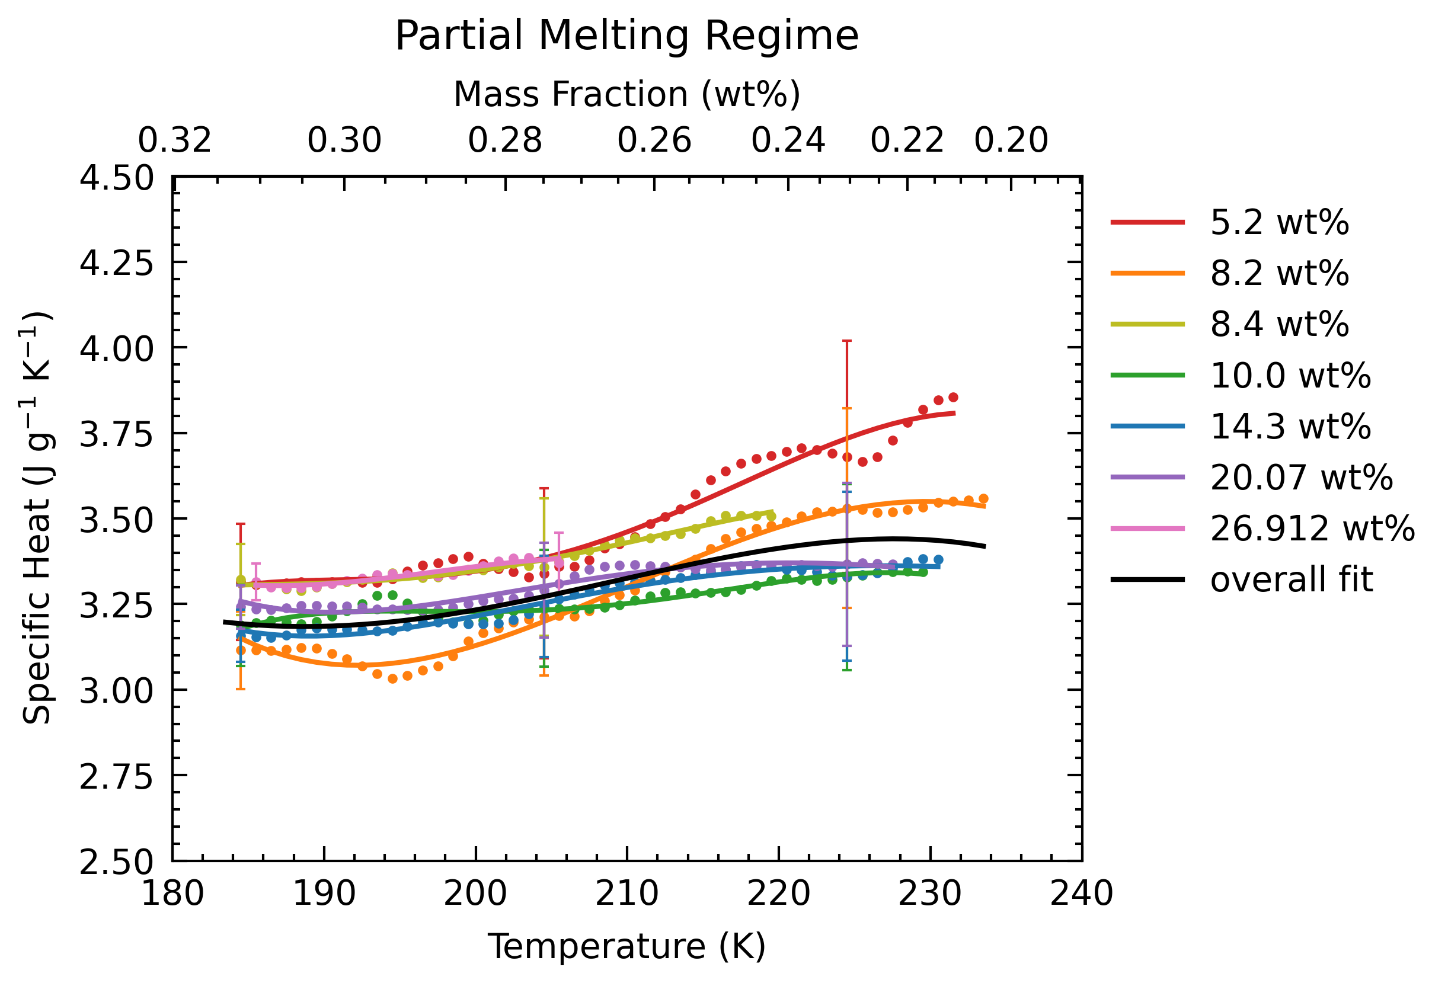
Smoothing before Calculations
CALCULATE THEN SMOOTH (OLD)
SMOOTH THEN CALCULATE

Slide 5
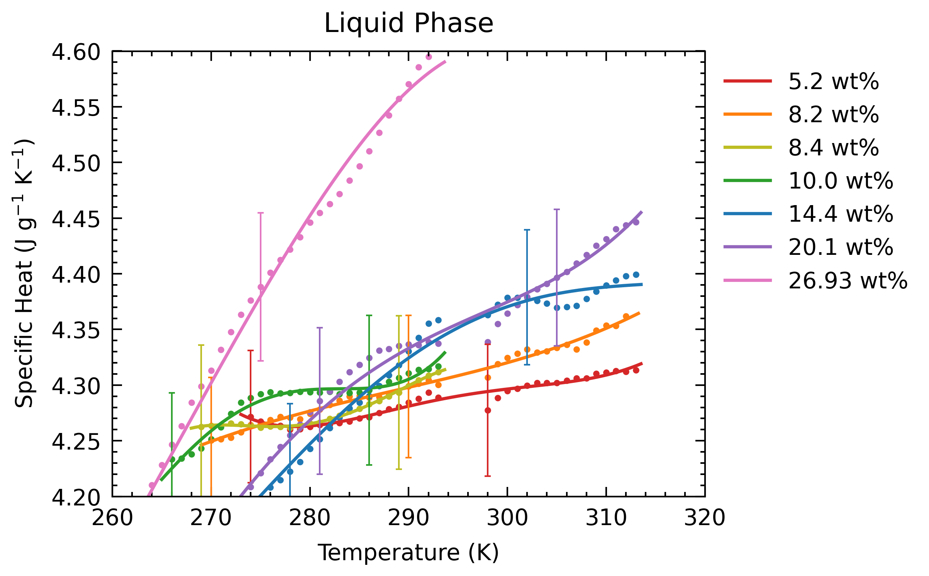
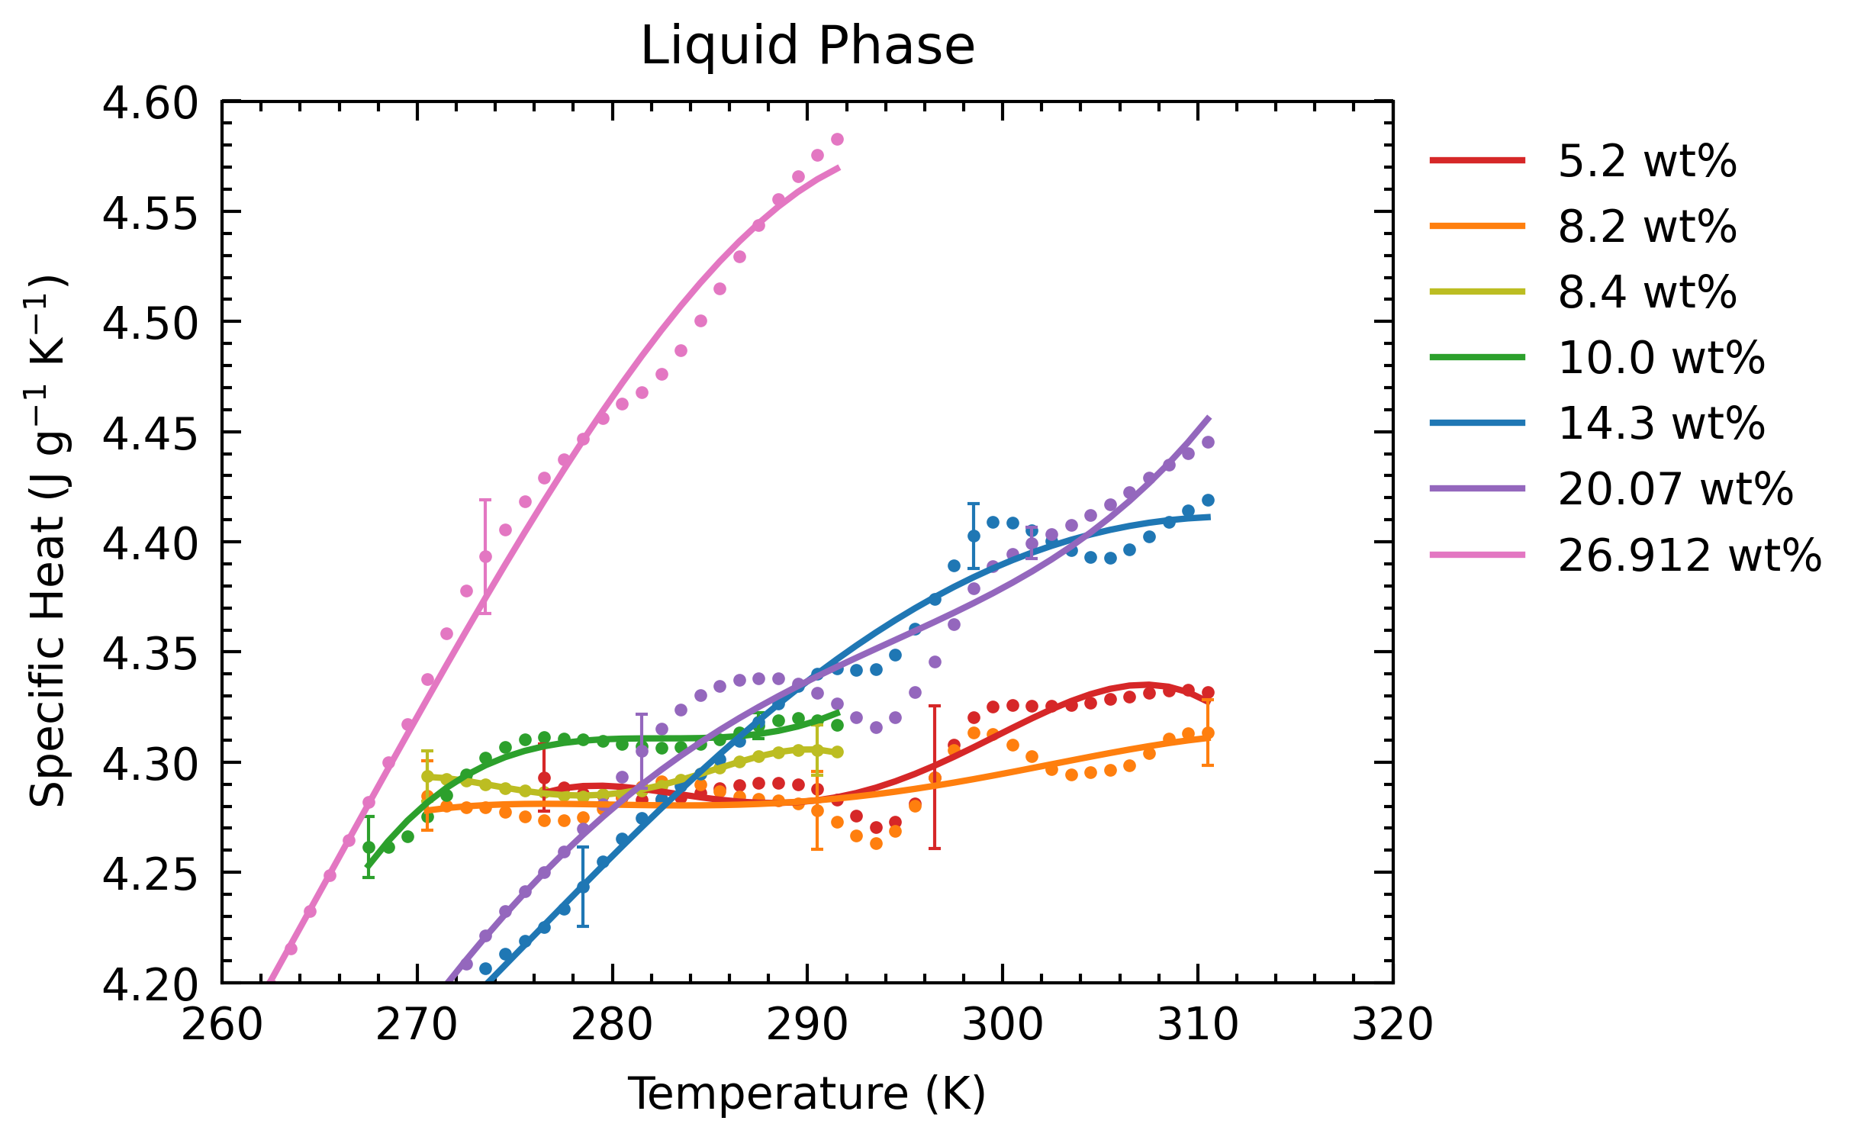
Smoothing before Calculations
CALCULATE THEN SMOOTH (OLD)
SMOOTH THEN CALCULATE

Slide 6
Smoothing before Calculations
Chose 3K bins
Error bars are 1-sigma of Cp datapoints.
Still trying to figure out how to obtain 2-sigma confidence interval of shomate fit.
(I have sigma of each coefficient in shomate)

Slide 7
Smoothing before Calculations
Chose 3K bins
Error bars are 1-sigma of Cp datapoints.
Still trying to figure out how to obtain 2-sigma confidence interval of shomate fit.
(I have sigma of each coefficient in shomate)
Overall shomate fit seems within 1-sigma of data

Slide 8
Smoothing before Calculations
Kink ~295K. My thoughts are to remove datapoints here (quite a few), as it appear to affect shomate
Chose 3K bins
Error bars are 1-sigma of Cp datapoints.
Still trying to figure out how to obtain 2-sigma confidence interval of shomate fit.
(I have sigma of each coefficient in shomate)

Slide 9
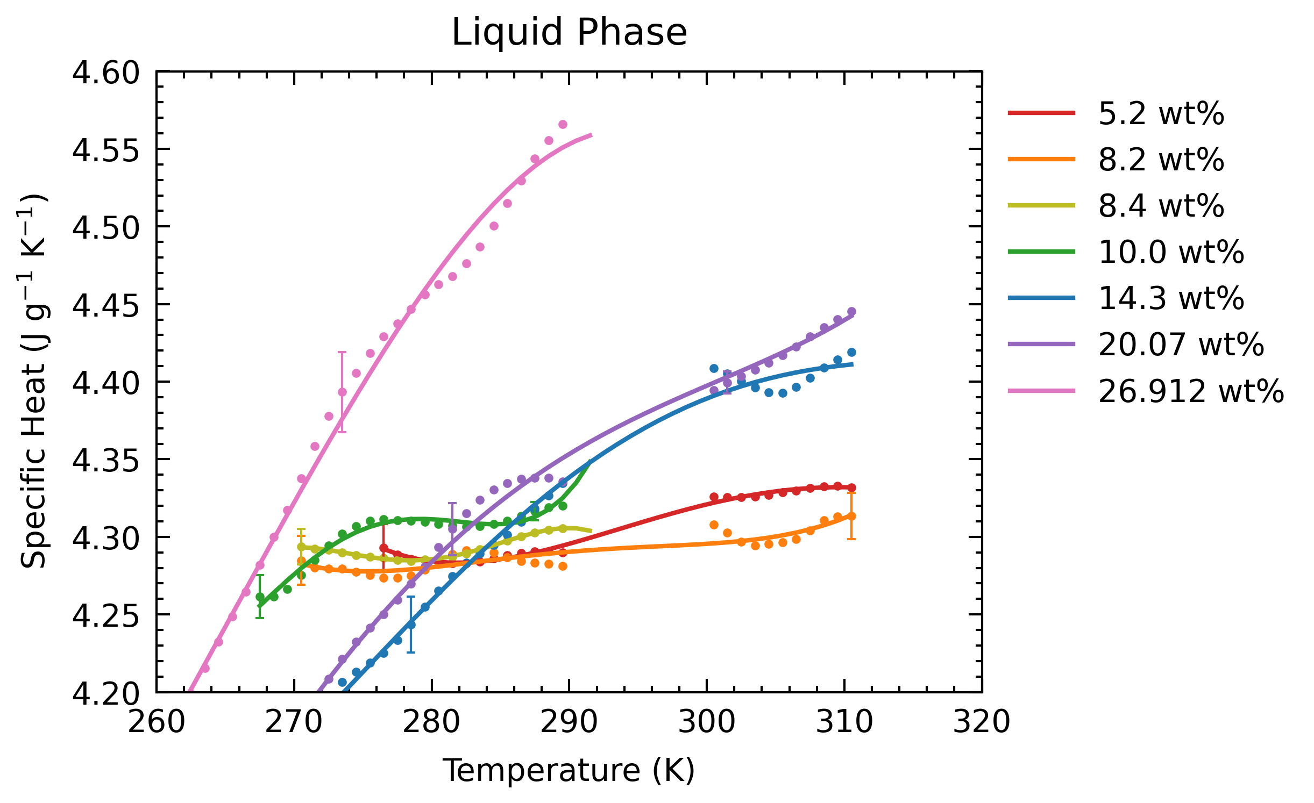
Smoothing before Calculations
Kink ~295K. My thoughts are to remove datapoints here (quite a few), as it appear to affect shomate

Slide 10
Smoothing before Calculations
Kink ~295K. My thoughts are to remove datapoints here (quite a few), as it appear to affect shomate
Chose 3K bins
Error bars are 1-sigma of Cp datapoints.
Still trying to figure out how to obtain 2-sigma confidence interval of shomate fit.
(I have sigma of each coefficient in shomate)

Slide 11
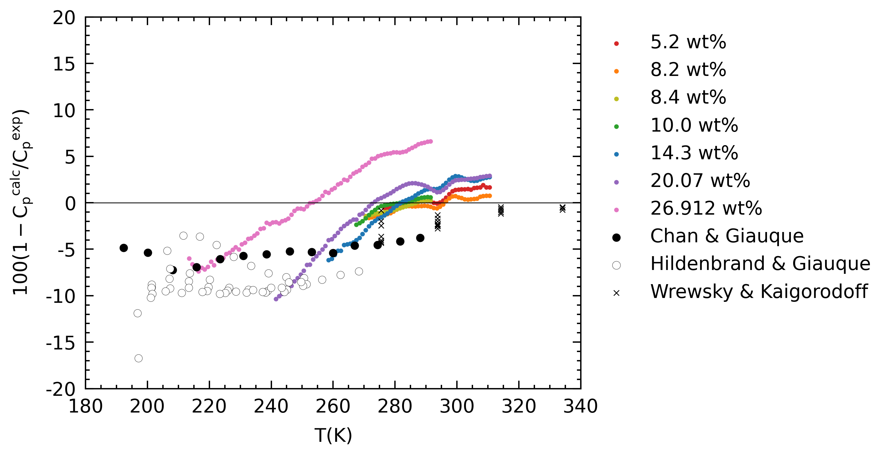
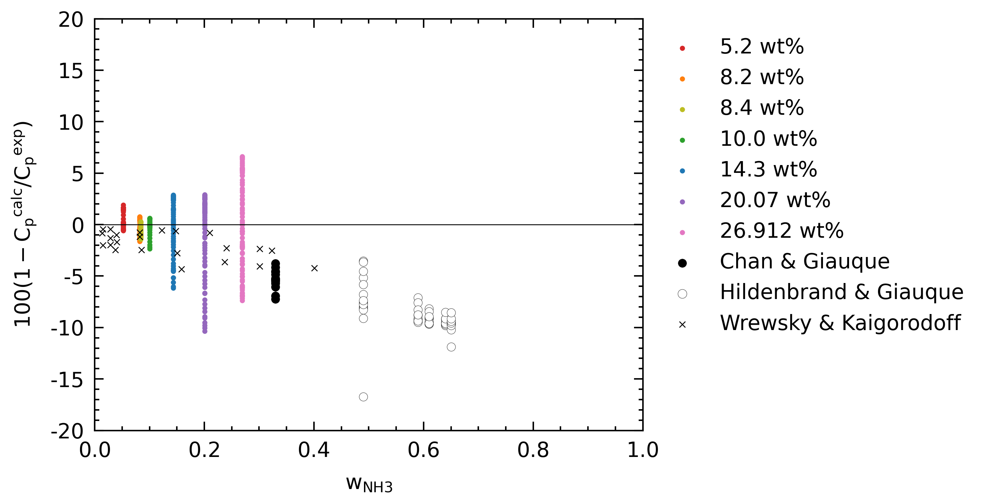
Deviations

Slide 12
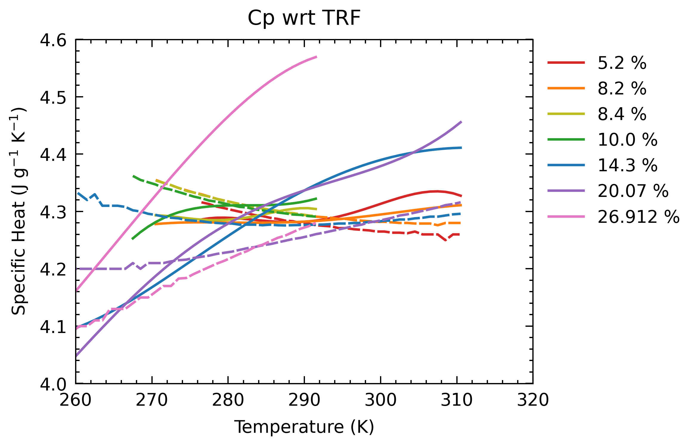
Deviations
Dashed lines are Tillner-Roth & Friend
TRF suggests a crossover point ~298K

Slide 13
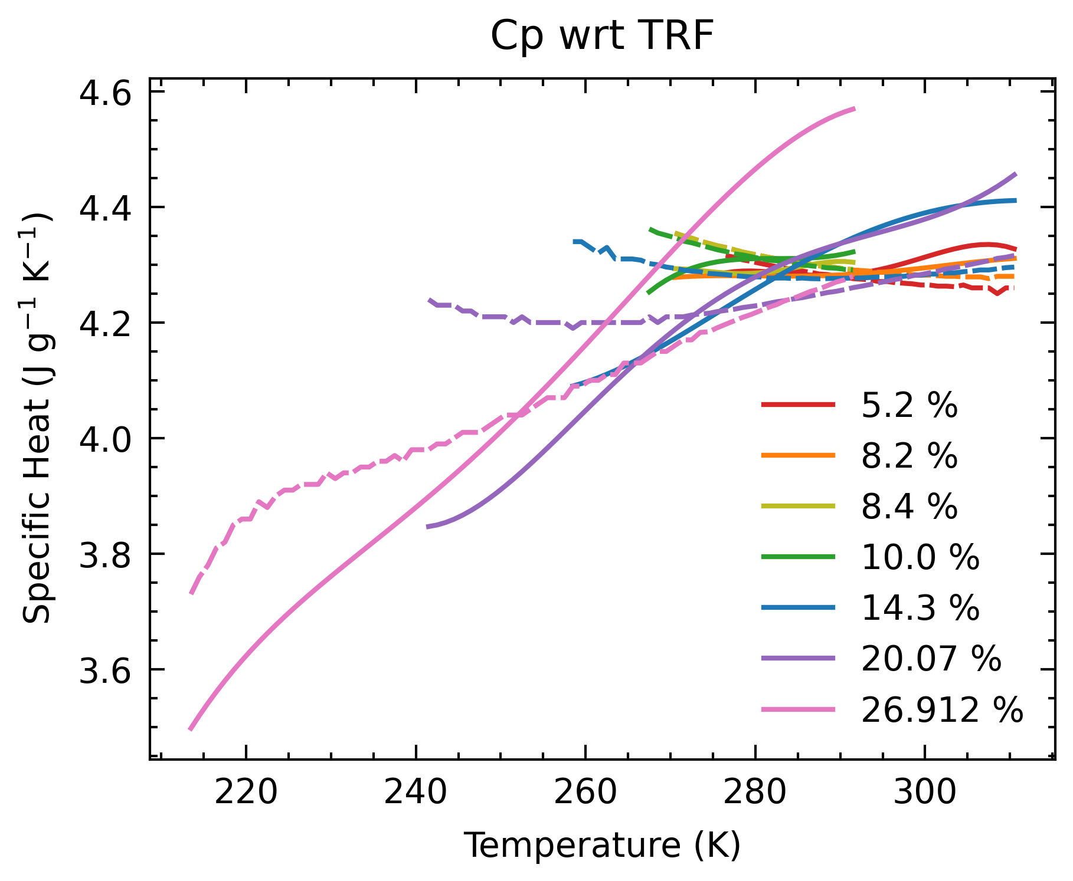
Deviations
Dashed lines are Tillner-Roth & Friend
General uptrend of model in low wt %

Slide 14
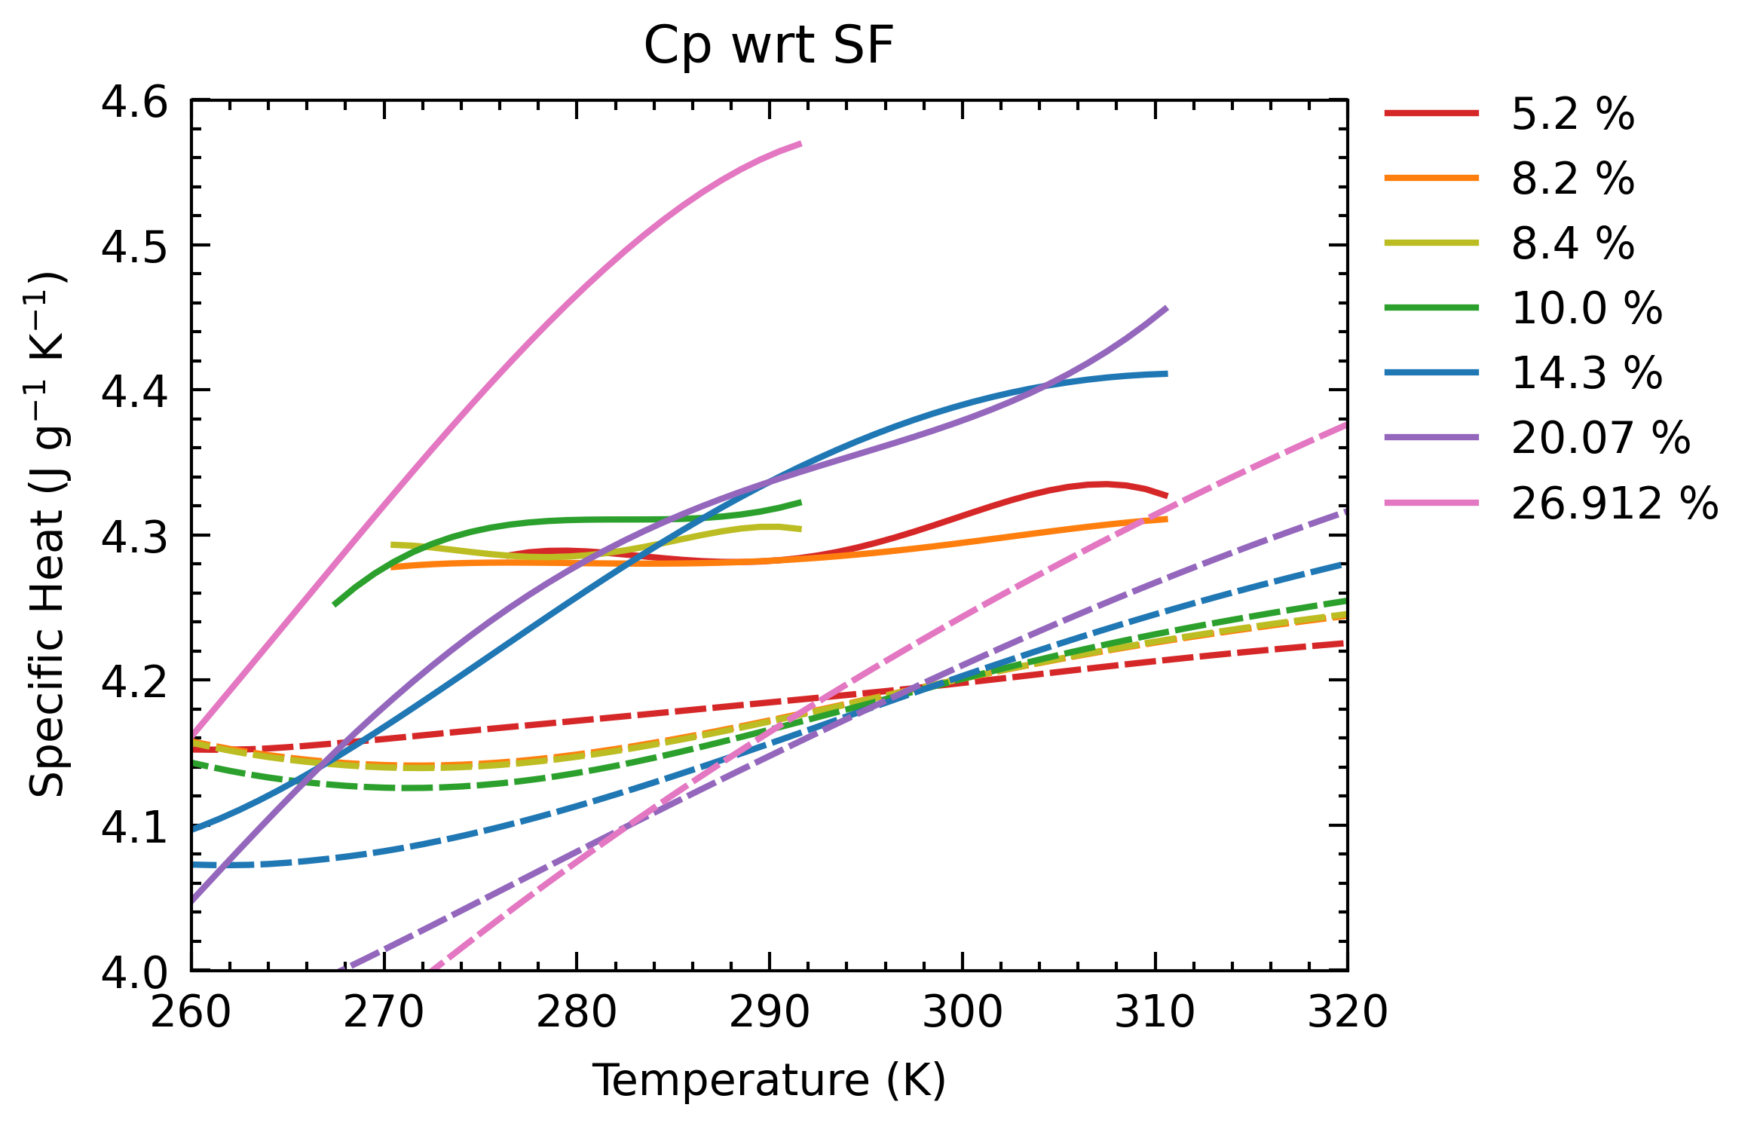
Deviations
Dashed lines are SeaFreeze (LBF_2_2p3GPa.mat)
SF also has crossover ~298K

Slide 15
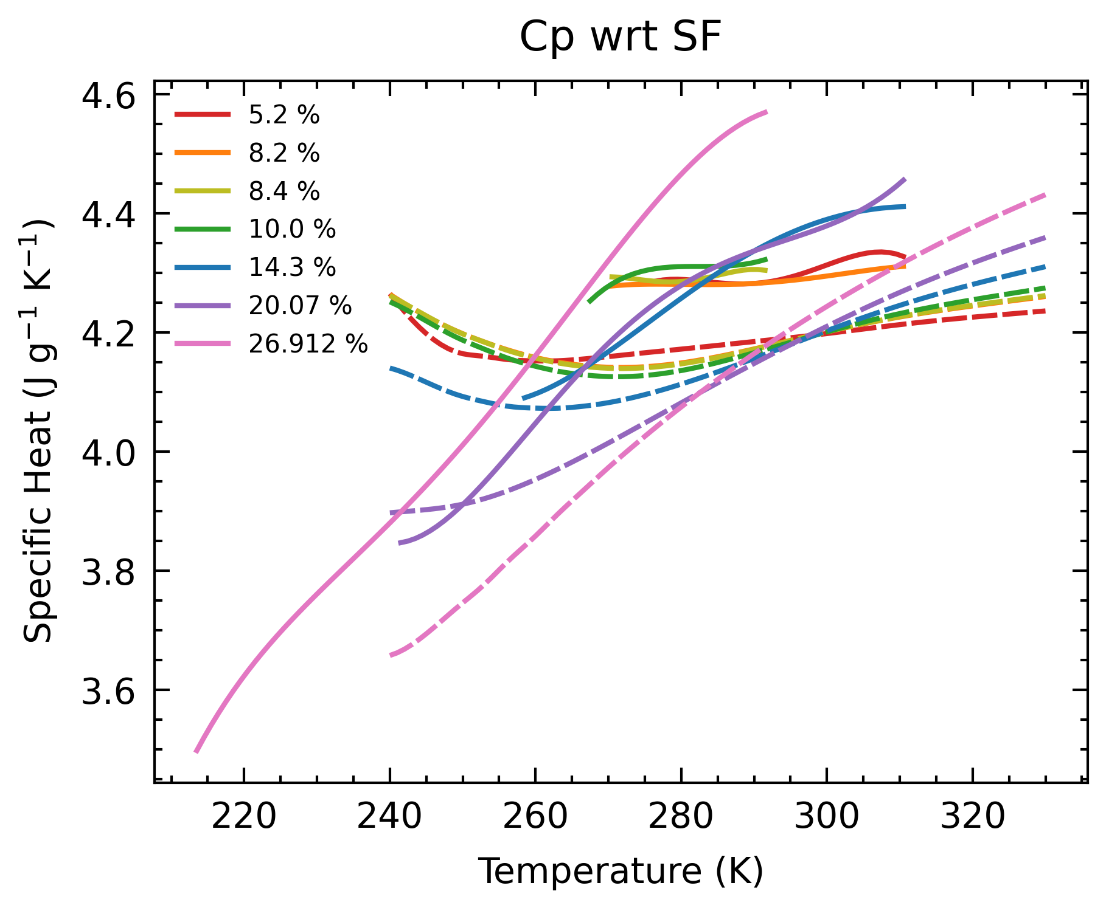
Deviations
Dashed lines are SeaFreeze (LBF_2_2p3GPa.mat)

Slide 16
Manuscript in progress
https://www.overleaf.com/3299537498fhjqhckknjms
Request for comments:
Introduction
Experimental methods (after tomorrow)
Results (after next Thursday)
Discussion:
How this work compares with current models (TRF, SF)
1st order planetary implications

Slide 17
Leftover questions
Are there systematic errors associated with calorimeter?
Do NaCl runs as a sanity check.
Require NaCl cp reference
Old experiments are saturated NaCl solutions, or >0.1 K/min
Is the equilibrium assumption in the partial melting regime valid?
Run at very low ramp rate (0.01 K/min)
Cuvette slide experiment

Slide 18
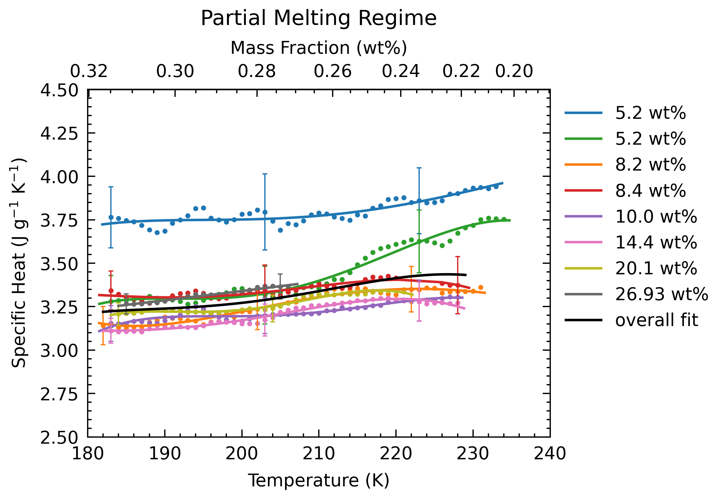
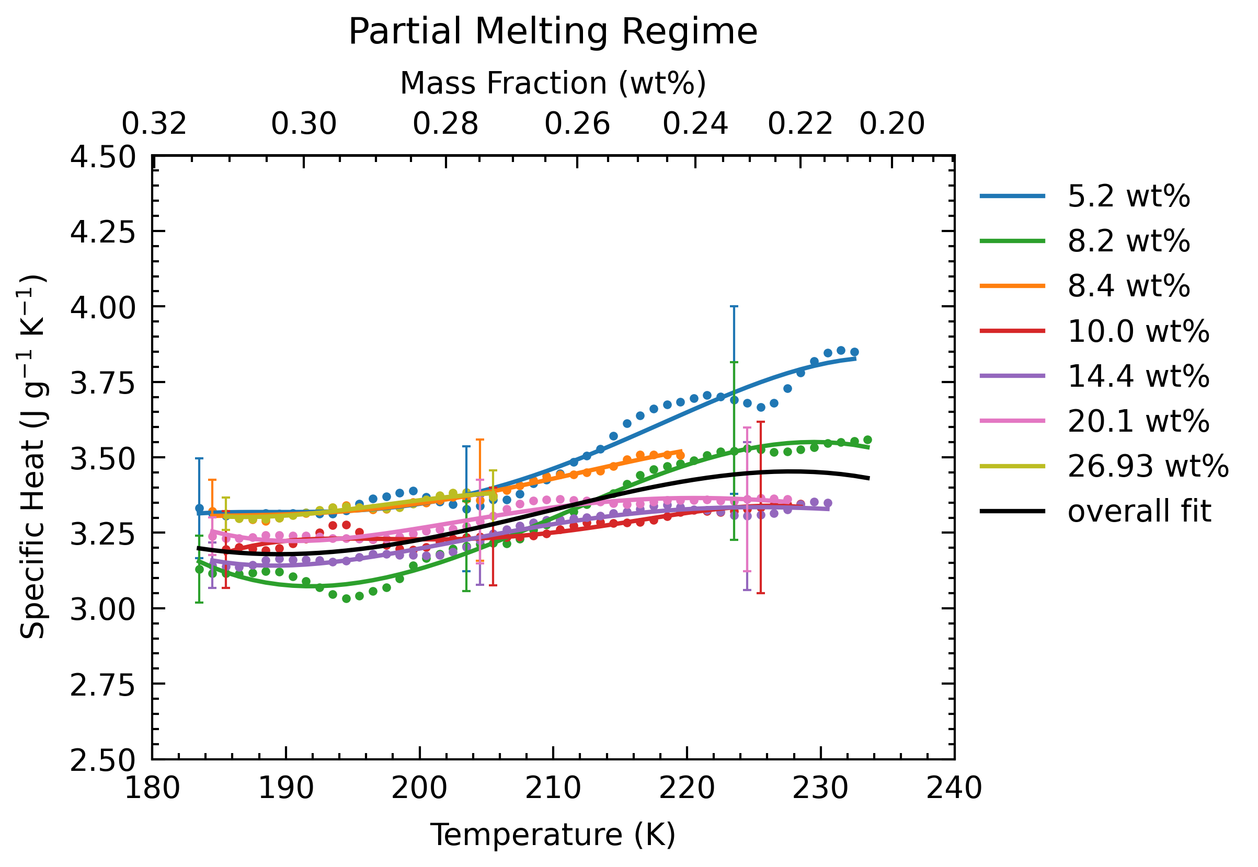
Smoothing before Calculations
Tried FFT
Doesn’t work on heat flow data

Slide 19
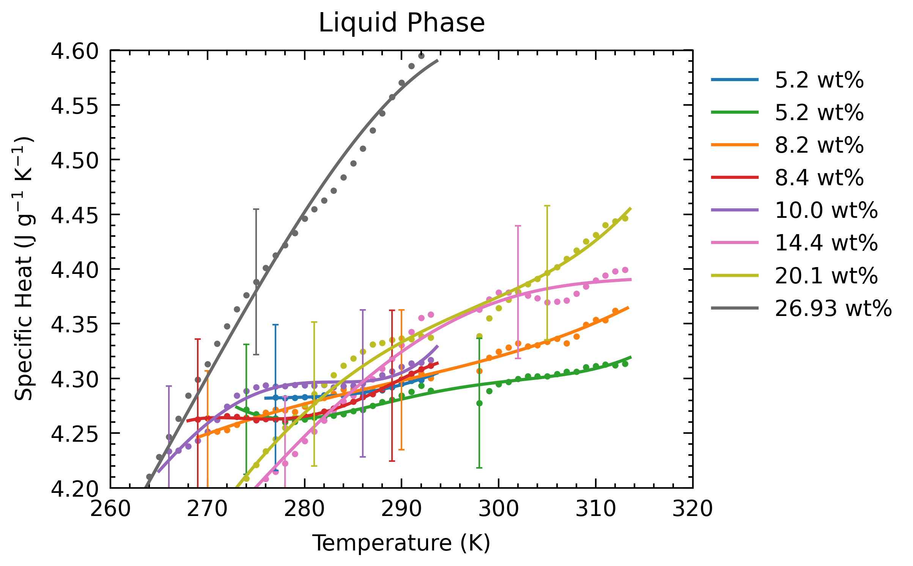
Current Result (3K averaging)
Dealing with oscillations & error bars: are they acceptable for applications?

Slide 20
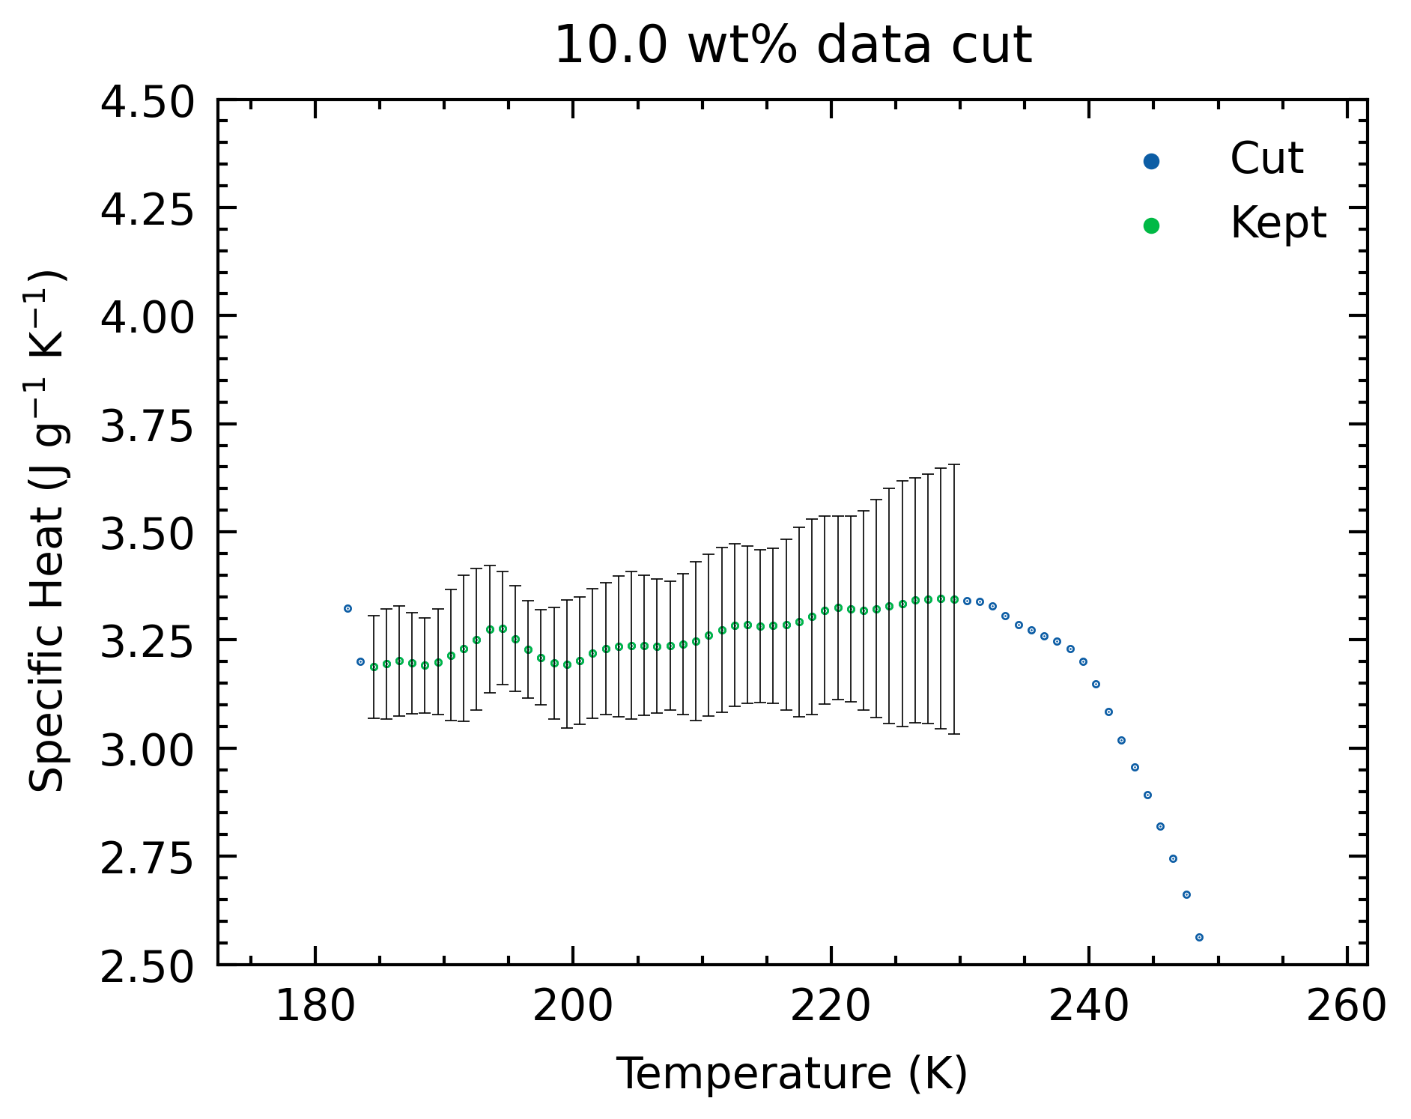
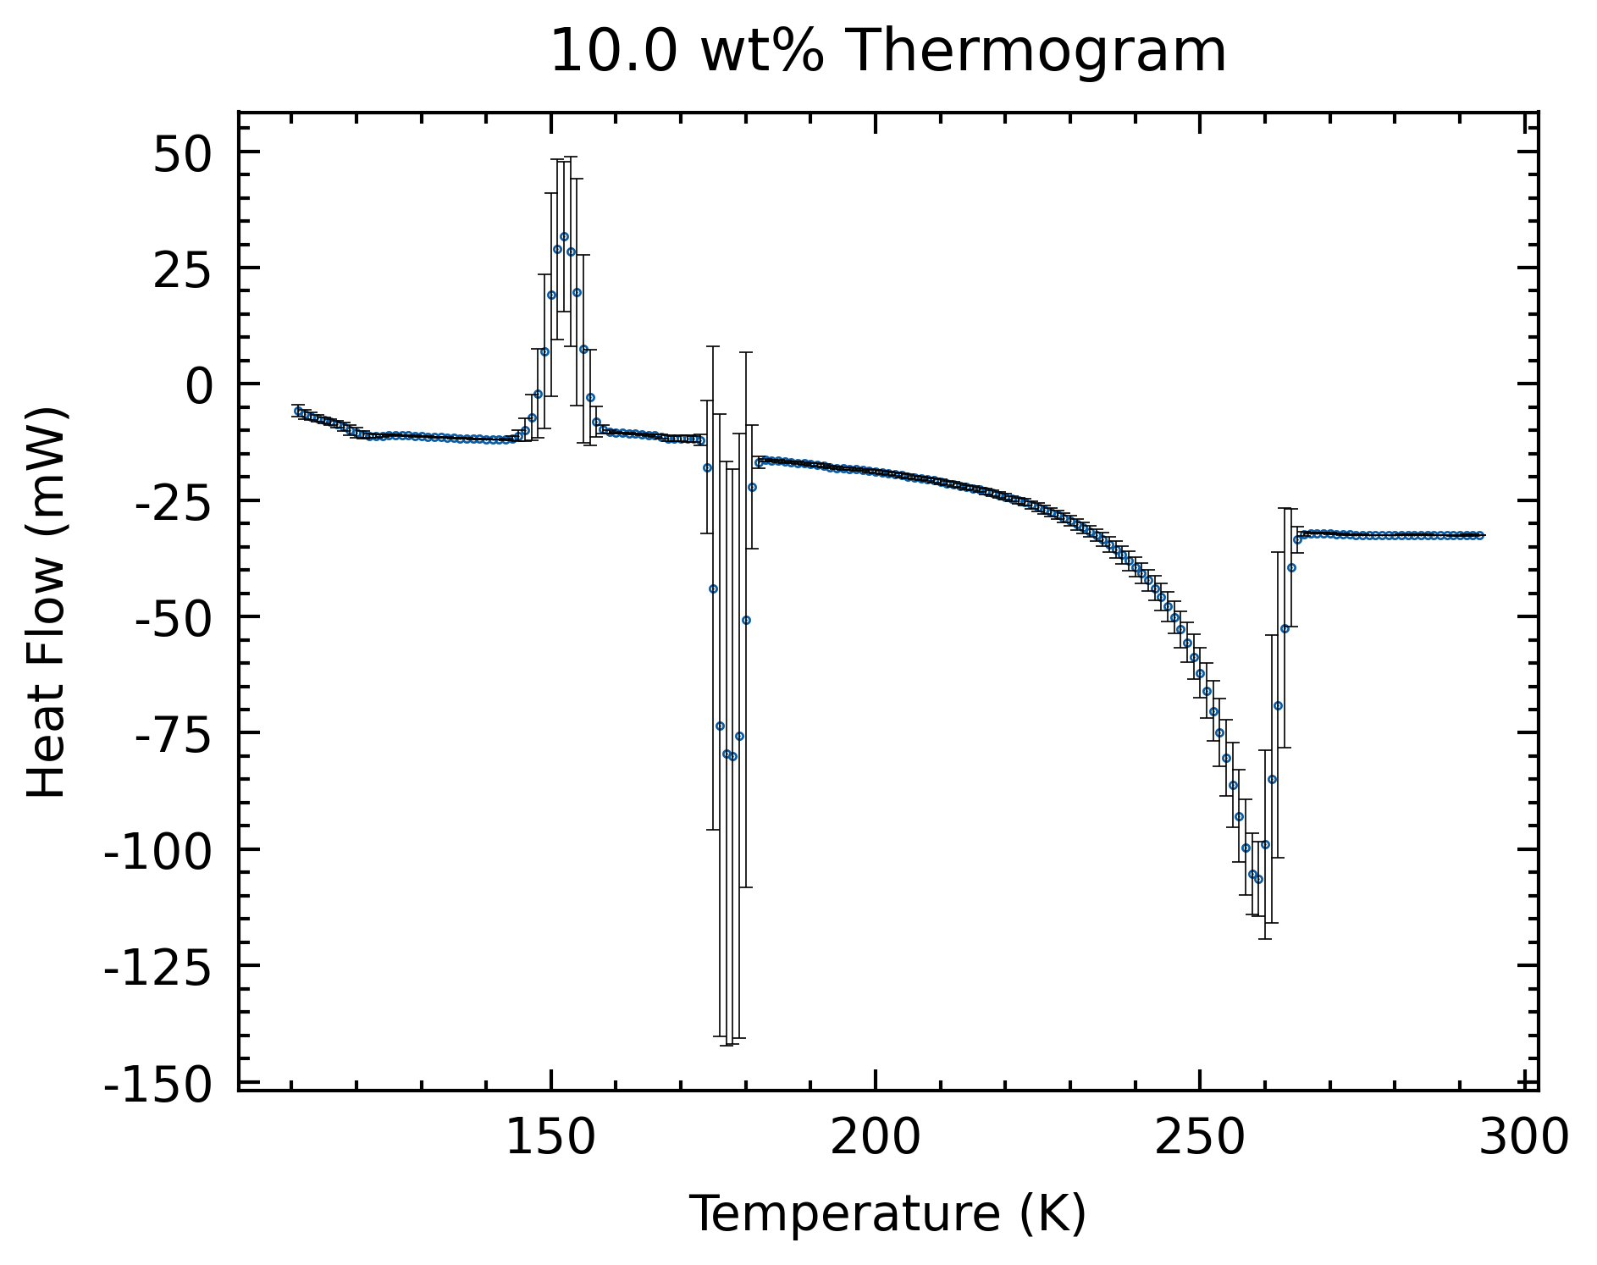
Current Result (3K averaging)

